Slide 1

AASD 4004
Machine Learning - II
Applied AI Solutions Developer Program

Slide 2
Module 08 Chatbots
Vejey Gandyer

Slide 3
Agenda
Chatbots
Why Chatbots?
Evolution
Types of Chatbots
Simple Chatbot
FAQ Chatbot
Wiki Chatbot
SoTA Chatbots *
* Deep Learning – I course

Slide 4
Chatbots
What is it?

Slide 5
Chatbots
A chatbot is one that will answer your query
Captures the intent of the user query and matches with the best possible response as an answer

Slide 6
Why

Slide 7
Why Chatbots?
To create an amazing user experience by answering questions
To decrease the manual labor by responding simple queries

Slide 8
Evolution

Slide 9
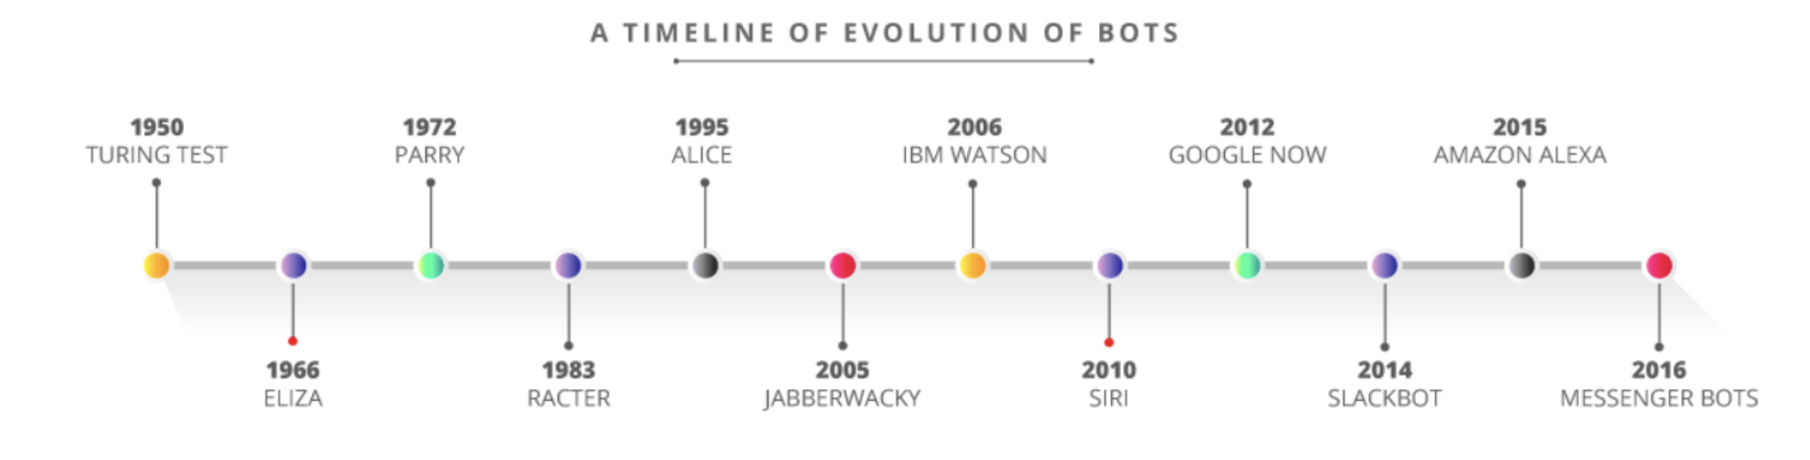
Evolution of Chatbots

Slide 10
Types of Chatbots

Slide 11
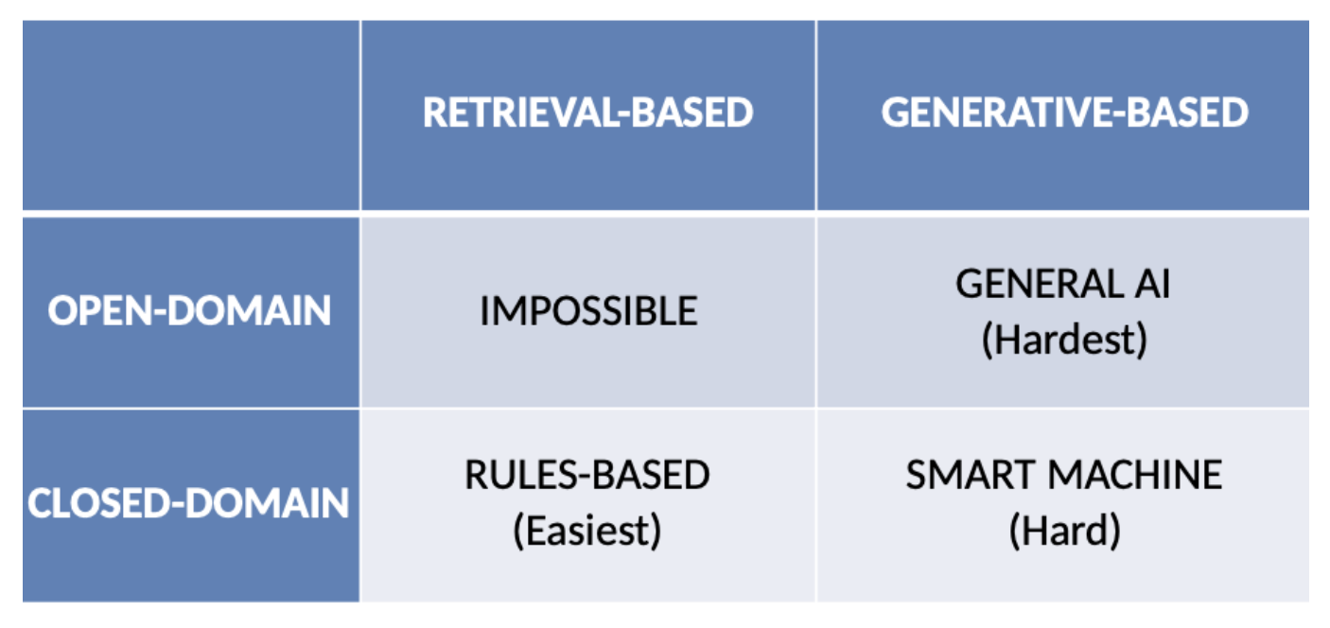
Types of Chatbots

Slide 12
Types of Chatbots
Dumb bots (Rule based)
Answer questions based on some simple rules that they are trained on.
Smart bots (Self-learning)
Relies on Artificial Intelligence(AI) & Machine Learning(ML) technologies to converse with users.
Retrieval-based chatbots
Generative chatbots

Slide 13
Retrieval Chatbots
Ranks the best response from a finite set of predefined responses
Responses are entered
manually
based on a knowledge base of pre-existing information

Slide 14
Retrieval Chatbots Examples
What are your store timings?
Answer: 9 AM to 5 PM
Where is my order?
Answer: It’s on its way and should reach you in 10 mins
Goal-oriented chatbot Applications
Customer support
Lead generation
Feedback

Slide 15
Simple Chatbot using Python

Slide 16
Simple FAQ Chatbot

Slide 17
Simple Wiki Chatbot

Slide 18
SoTA Chatbot

Slide 19
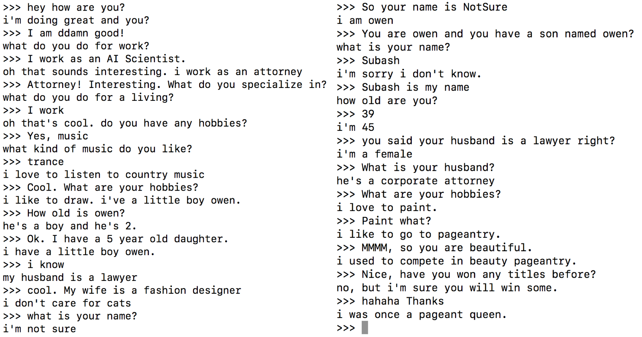
Persona Chatbot

Slide 20
Exercise: Building Chatbots

Slide 21
Building Chatbots
Create a list of Chatbots
- Simple Python Chatbot
- FAQ Chatbot
- Wiki Chatbot

Slide 22
Further Reading
Python libraries
- wikipedia
- CountVectorizer
- TFIDFVectorizer

